Slide 1

Sex Addicts Annonymous
DID/OSDD Meeting
Saturday, 11am EST, 10am CST,
9am MTN, 8am PST, 4pm UK
,

Slide 2

God, grant us the serenity
to accept the things we cannot change;
courage to change the things we can;
and wisdom to know the difference.

Slide 3
Zoom Video Etiquette:
Read by Trusted Servant when newcomers are present.

Slide 4
SAA-Related Announcements
Are there any SAA-Related Announcements?

Slide 5
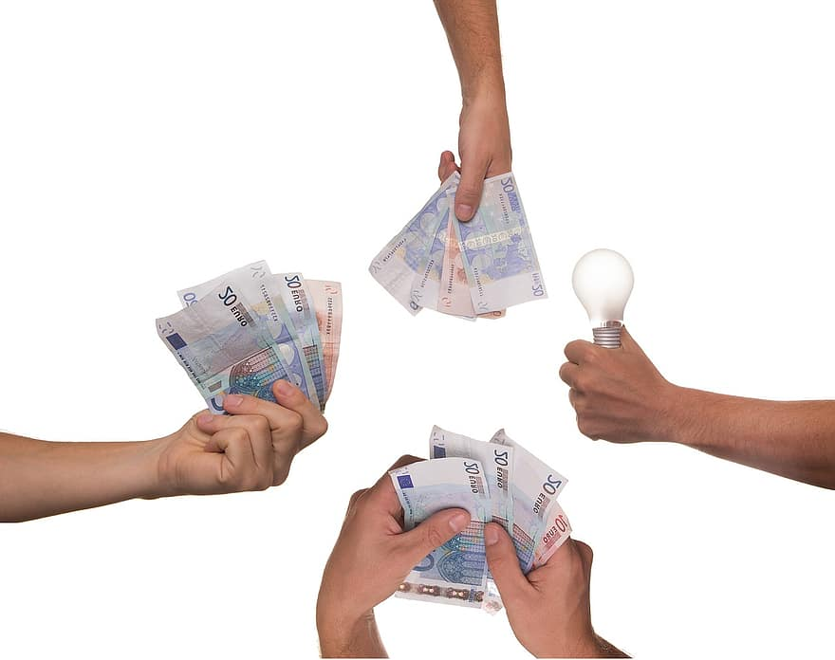
7th Tradition
“Every SAA group ought to be fully self-supporting, declining outside contributions.” The Telemeeting Intergroup relies on our donations to pay for the saatalk.info site and this ZOOM service. The Telemeeting Intergroup also donates to the ISO. To donate https://saatalk.info/us/donate.

Slide 6

Meeting Format
In this meeting, we may read from SAA literature, or someone may suggest a topic, followed by a period of sharing. On occasion we may have a speaker, or a 1st Step presentation. If you would like to be a speaker or share your 1st Step, more direction will be given at the end of the meeting.

Slide 7


Meeting Preamble
This is a Sex Addicts Anonymous meeting for people with DID or OSDD. SAA is a spiritual program based on the principles and traditions of Alcoholics Anonymous. Our primary purpose is to stop our addictive sexual behavior, protect our system, and to help other systems recover from sexual addiction. We find a new way of living through the SAA program, and carry our message to others seeking recovery. (Adapted from the Introduction, Sex Addicts Anonymous) PASS

Slide 8
ABSTINENCE STATEMENT
For many of us, our goal when entering the SAA program is abstinence from one or more specific sexual behaviors. But unlike programs for recovering alcoholics or drug addicts, Sex Addicts Anonymous does not have a universal definition of abstinence. Since different addicts suffer from different behaviors, and since our sexuality is experienced in so many different ways, it is necessary that SAA members define for themselves, with the help of their sponsors or others in recovery, which of their sexual behaviors they consider to be "acting out." (Excerpted from Sex Addicts Anonymous, pages 14-15) PASS

Slide 9
The 12 Steps of SAA
We admitted we were powerless over addictive sexual behavior—that our lives had become
unmanageable.
Came to believe that a Power greater than ourselves could restore us to sanity.
Made a decision to turn our will and our lives over to the care of God, as we understood
God.
Made a searching and fearless moral inventory of ourselves.
Admitted to God, to ourselves, and to another human being the exact nature of our wrongs.
Were entirely ready to have God remove all these defects of character.
Humbly asked God to remove our shortcomings.
Made a list of all persons we had harmed and became willing to make amends to them all.
Made direct amends to such people wherever possible, except when to do so would injure
them or others.
Continued to take personal inventory and when we were wrong promptly admitted it.
Sought through prayer and meditation to improve our conscious contact with God, as we
understood God, praying only for knowledge of God’s will for us and the power to carry that out.
Having had a spiritual awakening as the result of these steps, we tried to carry this
message to other sex addicts and to practice these principles in our lives. PASS

Slide 10
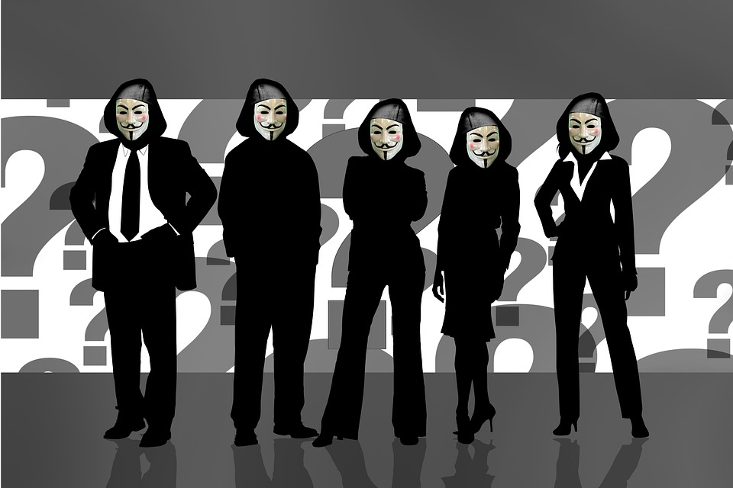

Anonymity Statement Read in unison
Anonymity means who you see here,
what you hear here,
when you leave here,
let it stay here!
“Here, here!”

Slide 11
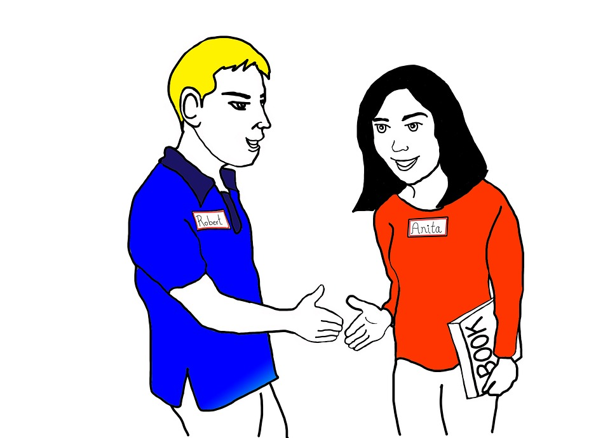
INTRODUCTION
• Your first name or names.
• Where you’re calling from
• A little about your system/Family/Team (optional)
• How you’re feeling right now in a few words
• An affirmation about yourself, if you wish.
However you identify is fine in this meeting.

Slide 12

Boundaries
We use respectful language while sharing our experience, strength, and hope about our recovery from sex addiction.
We understand that using the term “we” describes our own system, and not other systems. We avoid the use of “you” statements or directly commenting on others’ shares.
If you find yourself feeling triggered, here are some suggestions:
Turn off your speaker or lower the volume for a few minutes
Do grounding exercises, such as taking some deep breaths, and say to yourself, “I am safe, I have choices,” etc.
Raise your “virtual hand” or type the word “triggered” in the chat
Speak about it during fellowship after the meeting, or with your sponsor
Press the red “Leave” button if you need to exit the call
As a gentle reminder, this meeting is for sharing about recovery from sex addiction and is not a replacement for trauma therapy. Support or feedback can be offered after the meeting during fellowship, or during outreach calls.

Slide 13

Meeting Topic
Would someone like to suggest a Step, a Tradition
or other sex addiction recovery toppic?
Sharing our thought, feelings and experiences in recovery.

Slide 14

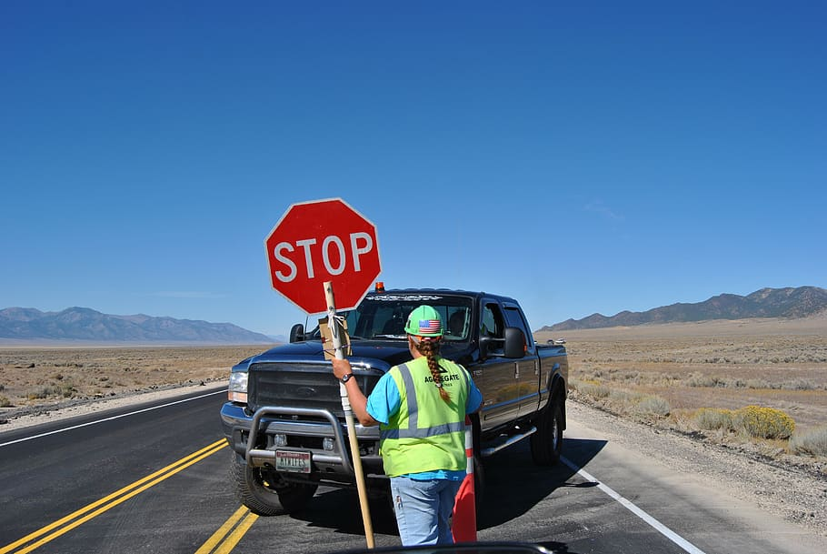
Stop Sharing Screen

Slide 15
Meeting WRAP-UP
That’s all the time we have for this portion of the meeting.
It is now time to accept a volunteer for Next week's service positions. Who feels led to be next week's Trusted Servant?
Thank You _______________________ for volunteering to be next week's Trusted Servant.
Who feels led to be next week's Slide Sharing person?
Thank You _______________________ for volunteering to be next week's Slide Sharing person.
Everyone is invited to stay in the zoom room after the meeting where we will have a period of continued fellowship. Newcomers may also feel free to ask any questions at that time.
Our business meeting is held directly following the last meeting of the month.
(If that is today, announce that the business meeting will start immediately after the closing prayer.)
If anyone would like to give a First Step Presentation, please talk with today’s Trusted Servant after the meeting.

Slide 16
The Ottawa Promises
Through a renewed relationship with our Higher Power, the healing force of recovery will take hold in our hearts. By giving ourselves over to our Higher Power and working our program, our lives will become manageable and we will be restored to sanity. We will receive the inner strength and support needed to face our anxieties and fears, and to deal with the painful feelings that feed our addiction. Relations with others will improve as we learn to respect our boundaries and allow others freedom to be themselves. Reaching out in trust and connecting with others will come easier, dispelling our sense of isolation and loneliness. Degrading fantasies and obsessive sexual thinking will diminish.
In relating to ourselves, self-absorption will give way to self-discovery; secrecy to honesty; feelings of unworthiness to dignity; and shame to grace. A restored integrity will guide our behavior. We will feel more alive and regain a sense of happiness. We will hear ourselves laugh again and rediscover play. We will embrace change and will grow.
A spiritual awakening will free us from the tyranny of our addiction. An awareness of being guided by a Higher Power and supported by caring friends will sustain us. Regret for the past and worry for the future will give way to living for today. We will open ourselves to the amazing possibilities of a life worth living…our life.
Are these extravagant promises? (Everyone) “We think not!” We have seen them fulfilled. They are ours, if we want them and work for them. PASS

Slide 17
SAA book, page 61 (last 2 paragraphs)
Practicing these principles in our lives means applying program principles at home, at work, and wherever else we gather with others for a common purpose. As we grow spiritually, we find opportunities for service in virtually any situation. Our closest relationships may offer the most challenges to our honesty, compassion, and integrity, but we are often rewarded beyond our expectations. We find that spiritual principles can guide us in the everyday challenges of life, and they can help us face even loss, grief, and death with fortitude and grace. What we gain in this program is a blueprint for full and successful living, whatever may come.
We maintain our recovery by working a daily program, in the knowledge that although we can never be perfect, we can be happy today. We can live life on life’s terms, without having to change or suppress our feelings. Our serenity and sobriety grow as we continue to live according to spiritual principles. We enjoy the gifts that come from being honest and living a life of integrity. We ask for help when we need it, and we express our love and gratitude every day. We realize that everything we have been through helps us to be of service to others. We learn that the world is a much safer place than we had ever known before, because we are always in the care of a loving God. PASS

Slide 18
The Proposed SAA Promises
By cultivating our sexual sobriety and spiritual connection we will discover healthier experiences of sexuality. Our serenity will grow as we continue to live according to spiritual principles. The miracle of recovery from sex addiction will become a reality we experience every day. Working the twelve steps brings us many gifts:
We will find freedom from our addictive sexual behavior.
We will live in the present and enjoy our lives.
We will learn to be emotionally present during sexual experiences, and use our sexuality to express our love, appreciation and faith.
We will grow in humility and will be able to admit when we are wrong.
We will deepen our compassion and become more forgiving of others and ourselves.
We will keep the company of people who love and respect us.
We will start to see life in terms of growth, change, and transformation.
We will have a greater sense of belonging, emotional intimacy and true friendship with others and ourselves.
We will learn to express our affection, rather than seek power and control.
We will ask for and receive help when we need it.
We will experience profound healing from shame as we learn to let go and cultivate vulnerability.
We will see that the world is a much safer place than we had ever known before, because we are always in the care of a loving higher power.

Slide 19
God, grant us the serenity
to accept the things we cannot change;
courage to change the things we can;
and wisdom to know the difference.

